Slide 1

Investigating stem cell differentiation during injury in Hydra Vulgaris
Marion Hardy
4th rotation
Juliano Lab

Slide 2
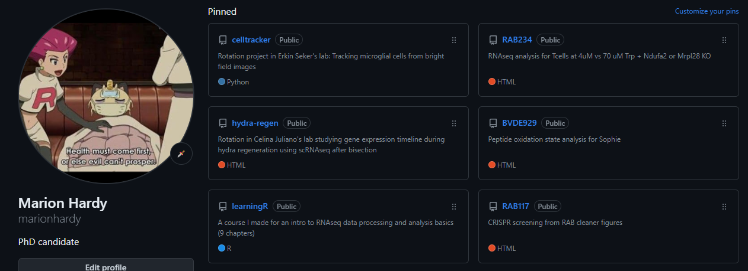
Preface: if you want to DIY, check this out
.Rmd = R script
.html = output
https://github.com/marionhardy/hydra-regen

Slide 3
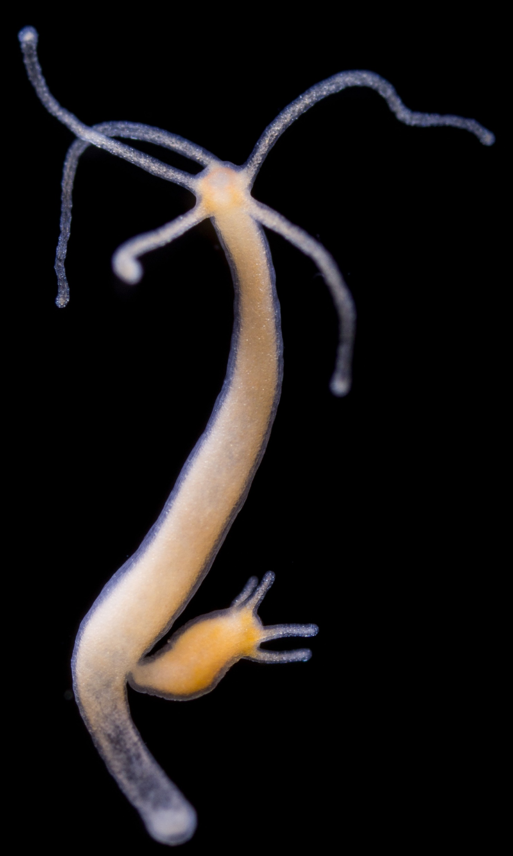
Hydra Vulgaris as a model for regeneration
Active stem cell populations that support fast and continual renewal of the entire animal
Whole body regeneration (first documented by Abraham Trembley in 1744)
Simple and well understood body plan with ~25 cell types
Photo Credits: Stefan Siebert

Slide 4
Hydra Vulgaris as a model for regeneration
Active stem cell populations that support fast and continual renewal of the entire animal
Whole body regeneration (first documented by Abraham Trembley in 1744)
Simple and well understood body plan with ~25 cell types
Photo Credits: Stefan Siebert

Slide 5
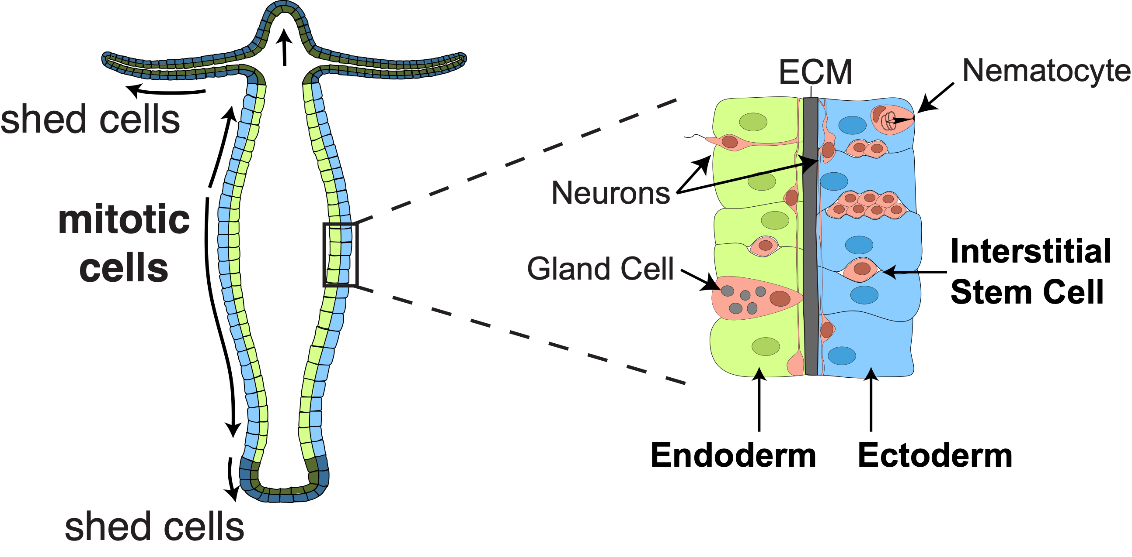
Hydra is in a constant state of renewal

Slide 6
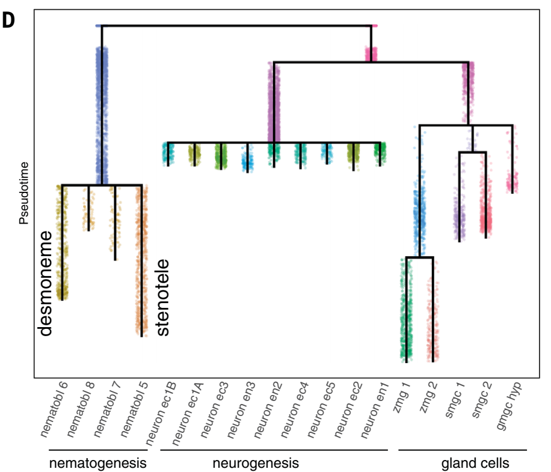
Hydra is in a constant state of renewal
Homeostatic animal
Stem cell
Bipotential progenitor
Gland cell progenitor
Neuron progenitor
Nb progenitor
Siebert S, Farrell JA, Cazet JF, Abeykoon Y, Primack AS, Schnitzler CE, Juliano CE. Stem cell differentiation trajectories in Hydra resolved at single-cell resolution. Science. 2019 Jul 26;365(6451):eaav9314. doi: 10.1126/science.aav9314. PMID: 31346039; PMCID: PMC7104783.

Slide 7
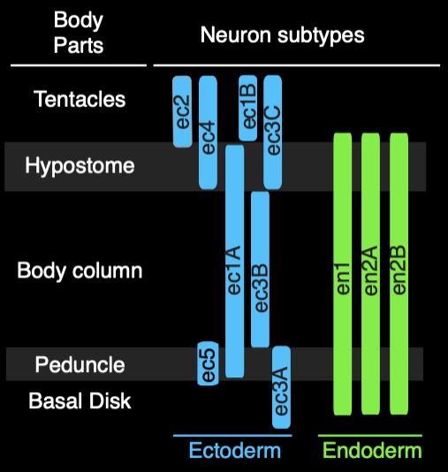
Hydra is in a constant state of renewal
Homeostatic animal
Stem cell
Bipotential progenitor
Gland cell progenitor
Neuron progenitor
Nb progenitor
Siebert S, Farrell JA, Cazet JF, Abeykoon Y, Primack AS, Schnitzler CE, Juliano CE. Stem cell differentiation trajectories in Hydra resolved at single-cell resolution. Science. 2019 Jul 26;365(6451):eaav9314. doi: 10.1126/science.aav9314. PMID: 31346039; PMCID: PMC7104783.

Slide 8
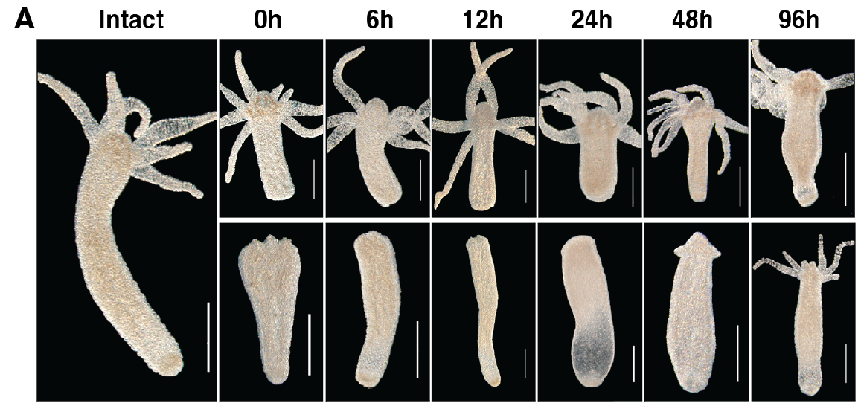
scRNAseq from Tsiairis lab: 96 hours time course post injury
https://doi.org/10.1101/2024.02.08.579449
REG_FOOT
REG_HEAD
20-40 Hydras cut in half per timepoint.
Notes:
Figure 1: A time course scRNA sequencing of Hydra regeneration captures 490 the emergence of missing
axial identities. (A) Hydra regenerates axial pattern after mid-gastric bisection. Animals regenerating oral
(lower panel) and aboral extremities (upper panel) are imaged at the indicated time points, corresponding
to those used for scRNA sequencing. Scale bar = 500μm.

Slide 9
My rotation project
Where and when are injury-specific transcription factors expressed in the scRNAseq data?
Where and when are injury-specific transcription factors expressed in the scRNAseq data?
Anything else interesting happening in the interstitial cells?

Slide 10
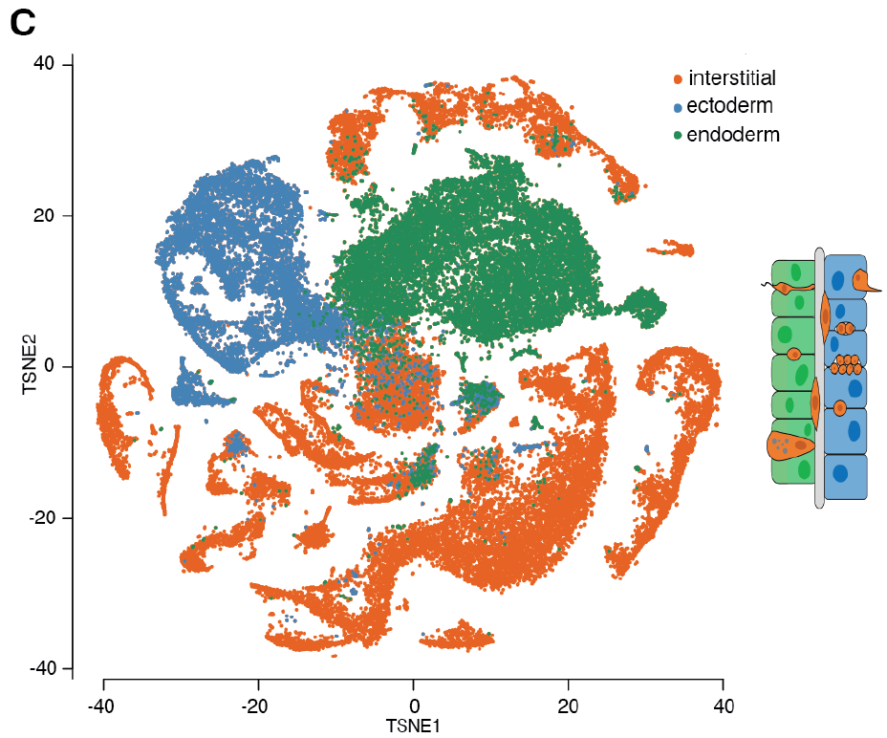
scRNAseq from Tsiairis lab: 3 main cell lineages detected
“Our approach allowed us to identify cells belonging to
ectodermal, endodermal, and interstitial cell lineages.”
=> No precise indication of the markers used
“8000 cells of all cell types and 8000 of enriched epithelial cells were sorted and collected […] for all time points.”
=> Not seeing a 10 000/6000 (1.5X) ratio
“Post-FACS survival assays, after incubation on ice for 30min, were performed to ensure that Hydra cells were
still viable.”
=> No filtering of cells based on MT- content

Slide 11
Experimental design: Please talk to your bioinformaticians
HEAD | 0h | 6h | 12h | 24h | 48h | 96h
Batch 1 | / | / | / | / | / | 3162
Batch 2 | 3486 | 3113 | 2173 | 1580 | / | /
Batch 3 | / | / | / | / | / | /
Batch 4 | / | / | / | / | 2057 | /
Batch 1 is only head 96h
FOOT | 0h | 6h | 12h | 24h | 48h | 96h
Batch 1 | / | / | / | / | / | /
Batch 2 | / | / | / | / | / | /
Batch 3 | 3054 | 2929 | 2623 | 2483 | / | 2190
Batch 4 | / | / | / | / | 1818 | /
Batch 4 is only 48h
Batch 3 is only foot

Slide 12
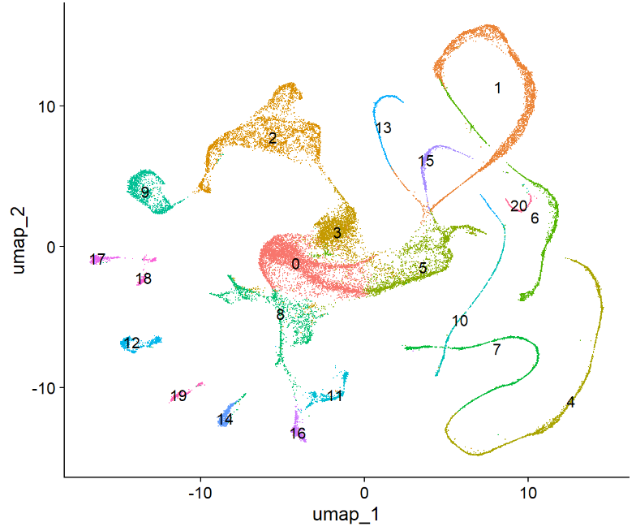
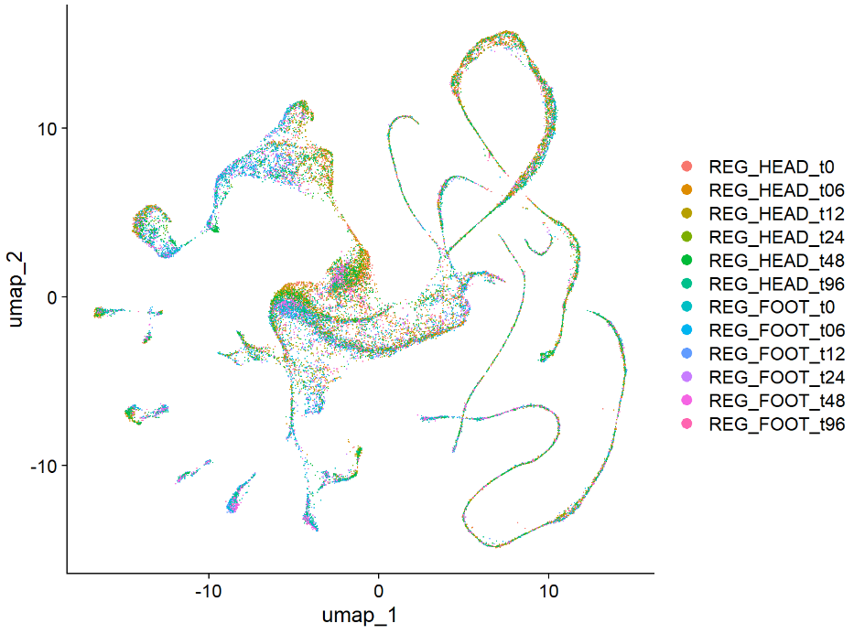
Interstitial cells object UMAP (big orange cluster →)
Cell type clusters
Body part + Timepoint

Slide 13
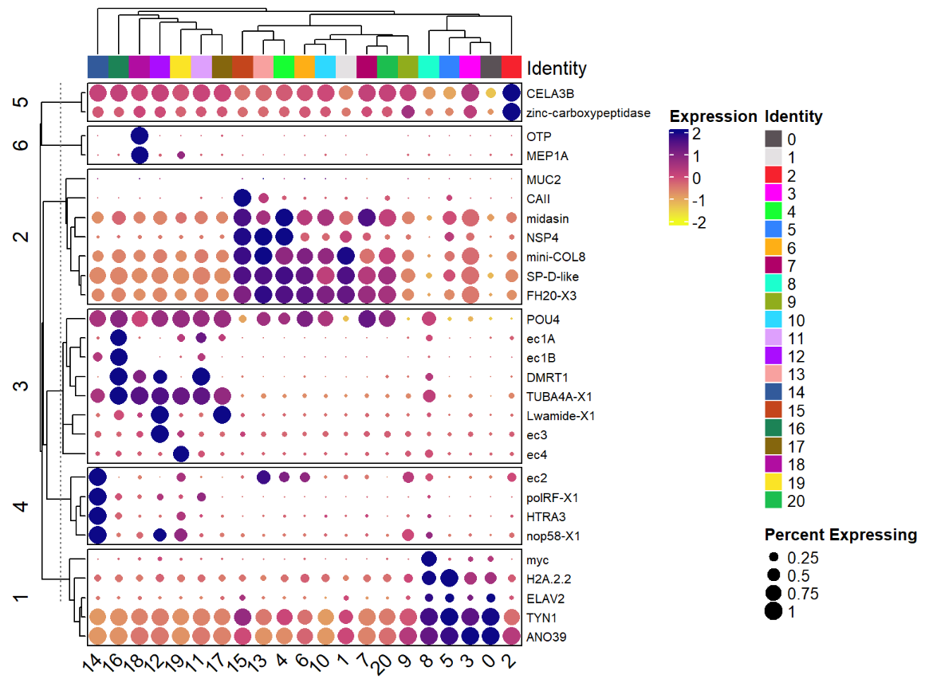
Cluster labelling: Cell type attribution
Head + Foot: All timepoints
Checked the Hydra cell atlas for cell type-specific markers

Slide 14
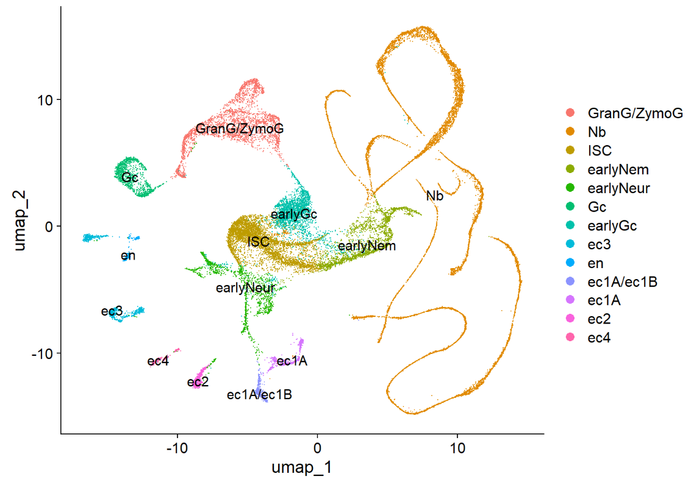
Cluster labelling: Cell type attribution
Head + Foot: All timepoints
Neurons not found: en subtypes, foot-specific neurons (ec5, ec3A/B)
Notes:
# midasin G006924 StenoNB I_ISC I_FemGC
# Lwamide G018128 Ec3N En1N
# CAII G023665 isoNB
# MEP1A G019984 En_tentacle En_Foot

Slide 15
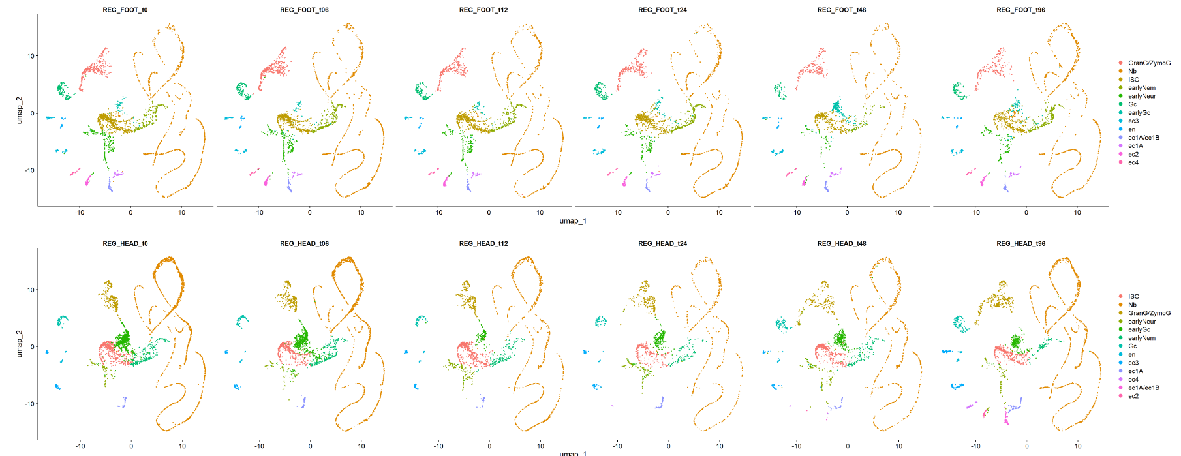
Head neurons and lands disappeared in the regenerating head
Notes:
Foot: No disappearing population
Head: Gland and neuron populations disappeared and reappeared => Will focus on head
The eye is not very good at telling us whether there were big shifts in cell pop except there/not there

Slide 16
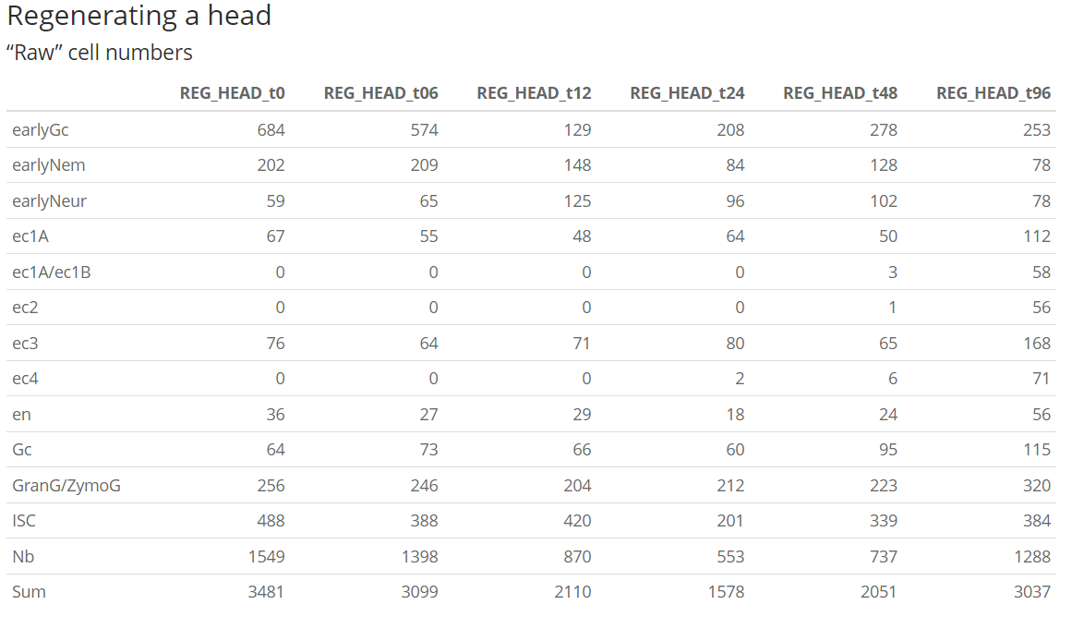
Head and foot population evolution after injury
“20-40 hydras were cut in half per time point. Both upper and lower parts were allowed to regenerate in HM
before being separately collected in 1.5mL tubes.”

Slide 17
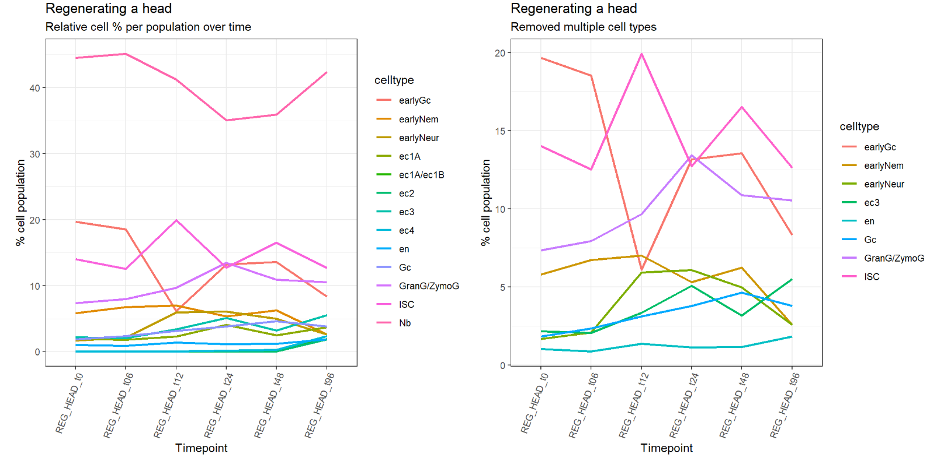
Regenerating a head cell population evolution after injury
This graph shows evidence for ISC being biased towards progenitor neurons production after injury

Slide 18
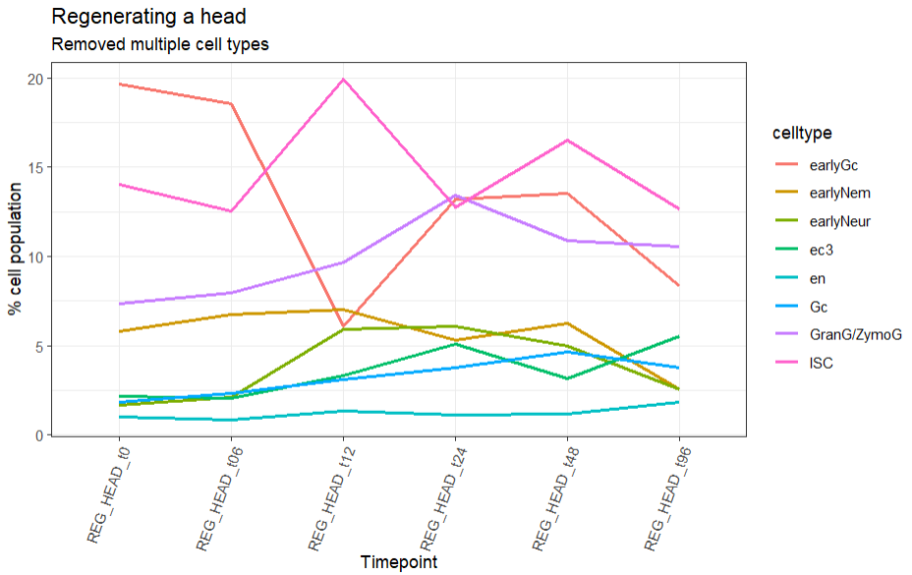
Part 1: stem cells and neurons unexpectedly get replenished first
Regenerating a head
20
earlyGc
Stem cells
% cell population
10
earlyNem
5
earlyNeur
0
0
6
12
24
48
96h

Slide 19
Hypothesis: Hydra prioritize neuronal regeneration
Homeostatic animal
20
earlyGc
Stem cell
Stem cells
Bipotential progenitor
10
Gland cell progenitor
% cell population
Neuron progenitor
earlyNem
Nb progenitor
5
earlyNeur
0
0
6
12
24
48
96h
Stem cell
Nb tree
Bipotential progenitor
But how do they know??
Neuron progenitor
Gland cell progenitor
Siebert S, Farrell JA, Cazet JF, Abeykoon Y, Primack AS, Schnitzler CE, Juliano CE. Stem cell differentiation trajectories in Hydra resolved at single-cell resolution. Science. 2019 Jul 26;365(6451):eaav9314. doi: 10.1126/science.aav9314. PMID: 31346039; PMCID: PMC7104783.
Neurons
Gc

Slide 20
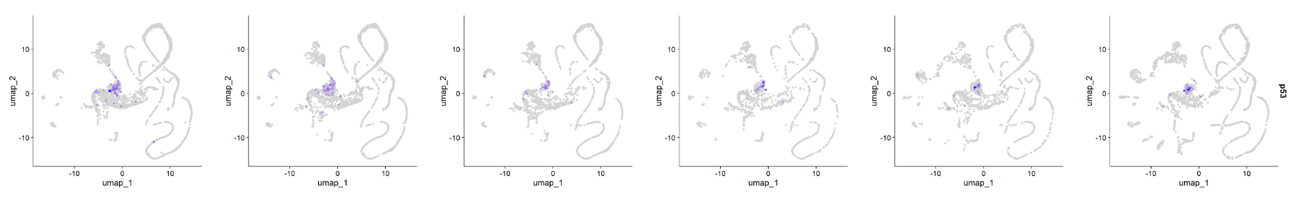
Part 2: earlyGc have p53 expression
p53 expression is located in the gland cell progenitors

Slide 21
Hypothesis: Hydra prioritize neuronal regeneration
20
earlyGc
Stem cells
4X drop!
% cell population
10
earlyNem
5
Hyp 1: Neuron progenitor are prioritized in stem cell differentiation
earlyNeur
0
Hyp 2: Hyp 1 + Gc can de-differentiate into stem cells
0
6
12
24
48
96h
Stem cell
Hyp 3: Hyp 1 + 2 + Gc can transdifferentiate into Neuron progenitors
Nb tree
Bipotential progenitor
Neuron progenitor
Gland cell progenitor
p53
Neurons
Gc

Slide 22
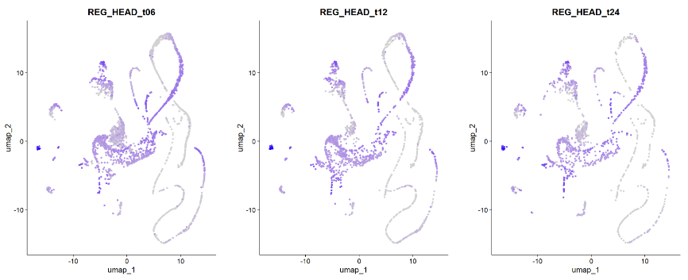
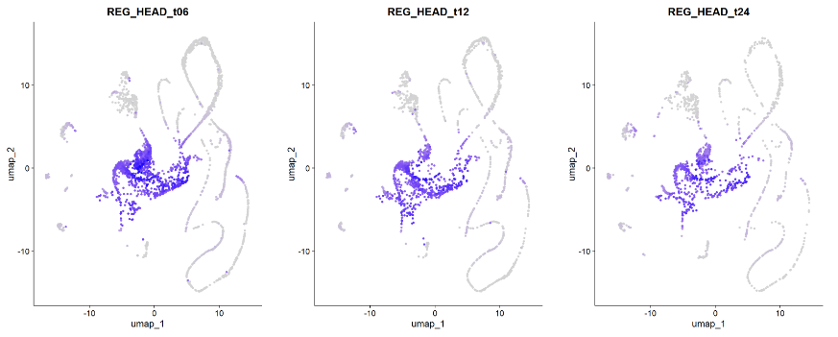
Hypothesis: Hydra prioritize neuronal regeneration
20
earlyGc
Hyp 1: Neuron progenitor are prioritized in stem cell differentiation
Stem cells
Hyp 2: Hyp 1 and Gc can de-differentiate into stem cells
% cell population
Hyp 3: Hyp 1 and Gc can transdifferentiate into Neuron progenitors
10
earlyNem
5
earlyNeur
0
Apoptosis score
0
6
12
24
48
96h
Stem cell
Nb tree
Bipotential progenitor
Neuron progenitor
Gland cell progenitor
Cycling score
p53
Neurons
Gc

Slide 23
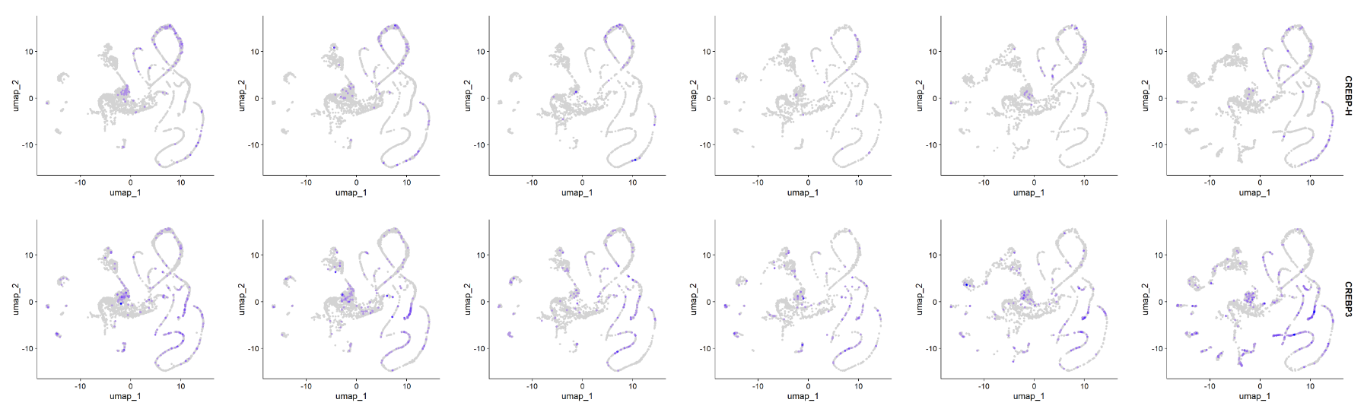
Markers that have patterns matching Gc changes in population
1. Introduction
CREBP-H and CREBP3 have expression peaks at t12h, when Gc population drops 4X and ISCs population increases 1.25X

Slide 24
Takeaways and future perspectives
Interesting takeaways
Neuron progenitors seem to be favored in the initial steps of regeneration post injury
Continuation of the project
Re-align the data to the 105 v3 genome
Make a new data set with enriched neurons to capture foot neurons
In situ and/or lineage tracing to explore hypotheses 2 and 3
Write a grant ehe

Slide 25
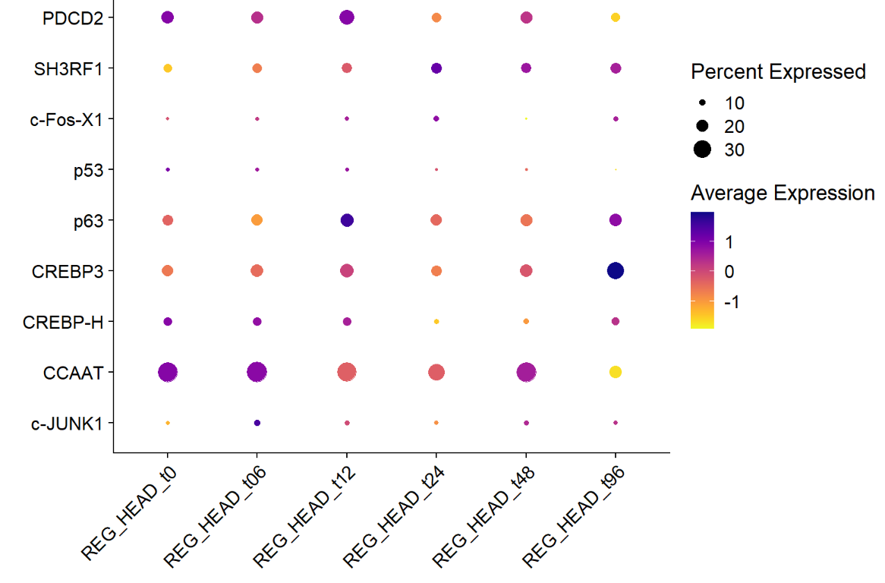
Also Hydra at t96h is not homeostatic
1. Introduction
Transcription factors present in the injured animal (bulk RNAseq) and absent in the homeostatic animal (Hydra atlas)

Slide 26
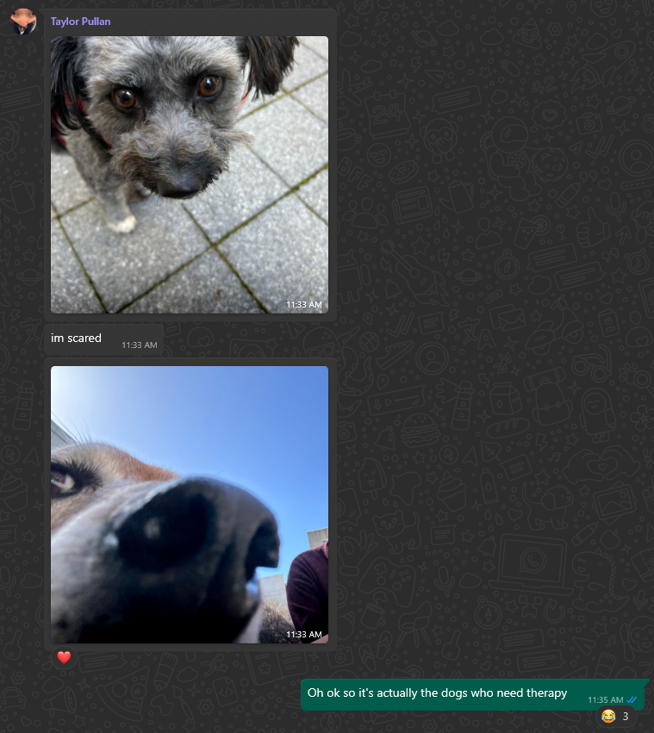
Acknowledgments
Celina Juliano
Hannah Morris Little
Malgosia Bzymek
Iris Yoshiko Juanico
Jennifer Tsverov
Ben Cox
Craig Ciampa
Kamille Maningding
Pranati Puttha
Dinh Hieu Pham
Jackson Crane
Divleen Lota
Kavita Ranade
My BMCDB cohort <3

Slide 27
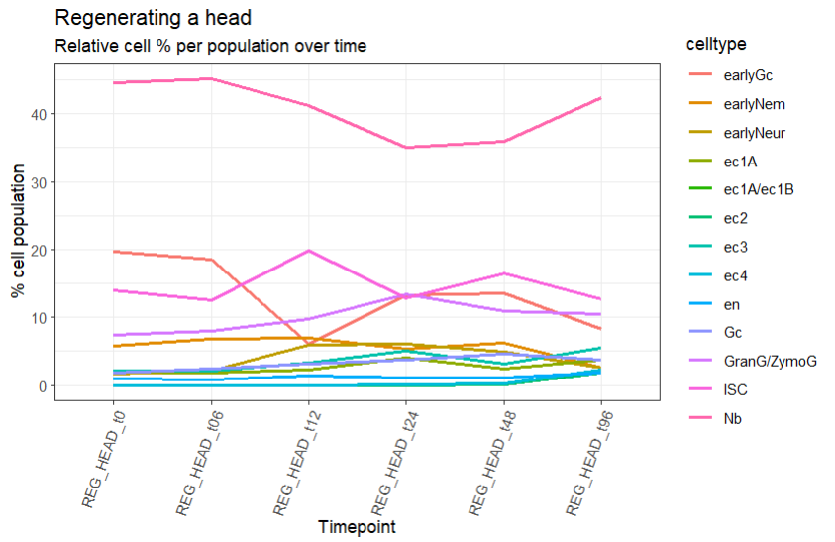
Part 1: Stem cells and neurons unexpectedly get replenished first

Slide 28
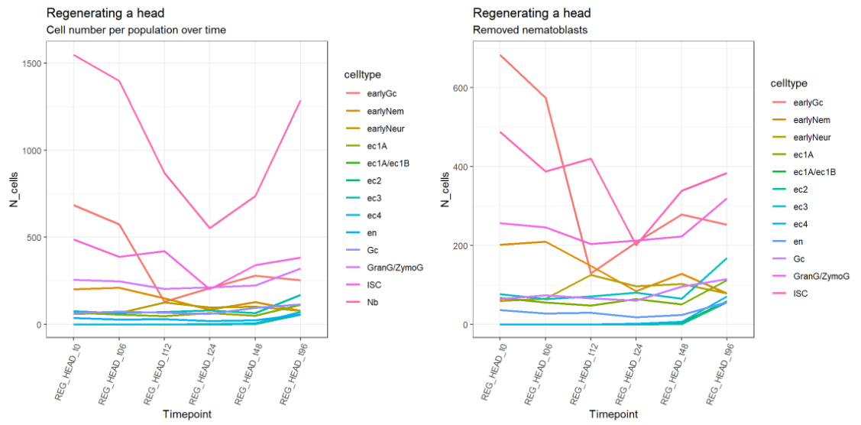
Head regeneration raw counts

